Slide 1
Diamond DA40 KAP 140 Autopilot
Blue Sky Aviation Association, Inc
Notes:
We are going to talk about MACA, Joint Operations, and Mission Approval
This is not complicated. I Promise

Slide 2
Overview
Equipment overview
Limitations
In-flight use
Climb out
Level off - Cruise
Approach
Missed approach
Effects of Equipment Failure

Slide 3
Controls and Indications
BENDIX/KING
KAP 144
HDG
AP
ALT
500
ARM
BARO
P
T
ALERT FT
UP
P
R
AP
HDG
NAV
APR
REV
ALT
DN
Autopilot engage/disengage button
Must be pressed and held
Turns AP on in default ROL (wing leveler) and VS mode
Turns AP off

Slide 4
Controls and Indications
BENDIX/KING
KAP 144
HDG
AP
ALT
500
ARM
BARO
P
T
ALERT FT
UP
P
R
AP
HDG
NAV
APR
REV
ALT
DN
Heading mode selector button
Selects heading mode
Turns airplane to maintain heading under heading bug
Used to toggle between ROL and Heading mode

Slide 5
Controls and Indications
BENDIX/KING
KAP 144
HDG
AP
ALT
500
ARM
BARO
P
T
ALERT FT
UP
P
R
AP
HDG
NAV
APR
REV
ALT
DN
Navigation mode selector button
Automatic capture of and tracking of VOR, LOC, or GPS signals set on HSI
Recommended for enroute navigation

Slide 6
Controls and Indications
BENDIX/KING
KAP 144
HDG
AP
ALT
500
ARM
BARO
P
T
ALERT FT
UP
P
R
AP
HDG
NAV
APR
REV
ALT
DN
Approach mode selector button
Capture and tracking of VOR, GPS, LOC and GS on ILS
Recommended for instrument approaches

Slide 7
Controls and Indications
BENDIX/KING
KAP 144
HDG
AP
ALT
500
ARM
BARO
P
T
ALERT FT
UP
P
R
AP
HDG
NAV
APR
REV
ALT
DN
Back course approach mode selector button
Capture of back course LOC
Response to LOC is reversed (*set the front course)
Only active when LOC freq is loaded

Slide 8
Controls and Indications
BENDIX/KING
KAP 144
HDG
AP
ALT
500
ARM
BARO
P
T
ALERT FT
UP
P
R
AP
HDG
NAV
APR
REV
ALT
DN
Altitude hold mode selector button
Toggles between ALT HOLD and VS mode

Slide 9
Controls and Indications
BENDIX/KING
KAP 144
HDG
AP
ALT
500
ARM
BARO
P
T
ALERT FT
UP
P
R
AP
HDG
NAV
APR
REV
ALT
DN
Vertical speed mode buttons
Action of button depends on AP mode when selected
When in VS mode, momentary press will show captured VS
Subsequent presses will change target VS by 100 ft.. per min
When established at an ARMed altitude, a momentary cycle will adjust the ARMed altitude 20 ft. (display will not change)

Slide 10
Controls and Indications
BENDIX/KING
KAP 144
HDG
AP
ALT
500
ARM
BARO
P
T
ALERT FT
UP
P
R
AP
HDG
NAV
APR
REV
ALT
DN
Altitude Arm button
Toggles altitude capture on (ALT ARM annunciated) and off
When armed AP will capture altitude displayed in alerter, if the current VS will direct an intercept.
Upon capturing altitude, the AP is armed for a new altitude

Slide 11
Controls and Indications
BENDIX/KING
KAP 144
HDG
AP
ALT
500
ARM
BARO
P
T
ALERT FT
UP
P
R
AP
HDG
NAV
APR
REV
ALT
DN
Barometric pressure button
Push to display baro setting.
Large and small knobs are then used to set the desired
current barometric pressure

Slide 12
Controls and Indications
BENDIX/KING
KAP 144
HDG
AP
ALT
500
ARM
BARO
P
T
ALERT FT
UP
P
R
AP
HDG
NAV
APR
REV
ALT
DN
Rotary Knobs
Used to set the altitude alerter
After pressing BARO button, knobs are used to set current barometric pressure

Slide 13
Controls and Indications
BENDIX/KING
KAP 144
HDG
AP
ALT
500
ARM
BARO
P
T
ALERT FT
UP
P
R
AP
HDG
NAV
APR
REV
ALT
DN
Altitude Alerter/vertical speed/BARO setting display
Displays altitude for altitude alerter. This is the ARMed altitude, chime sounds when 1000ft and 200 ft. from altitude
Shows captured or set VS after pressing UP/DN key
Shows BARO setting after pressing BARO

Slide 14
Controls and Indications
BENDIX/KING
KAP 144
HDG
AP
ALT
500
ARM
BARO
P
T
ALERT FT
UP
P
R
AP
HDG
NAV
APR
REV
ALT
DN
Pitch Trim annunciator
Indicates direction of trim
Flashes if trim is not satisfied in 10 seconds
Solid PT without an arrow is an indication of a fault

Slide 15
Controls and Indications
BENDIX/KING
KAP 144
HDG
AP
ALT
500
ARM
BARO
P
T
ALERT FT
UP
P
R
AP
HDG
NAV
APR
REV
ALT
DN
Autopilot engagement annunciator
On whenever AP is on
Flashes during pilot initiated or automatic disconnect

Slide 16
Controls and Indications
BENDIX/KING
KAP 144
HDG
AP
ALT
500
ARM
BARO
P
T
ALERT FT
UP
P
R
AP
HDG
NAV
APR
REV
ALT
DN
Pitch (P) and Roll (R) axis annunciator
Indicates failure of illuminated axis
In turbulent air P may illuminate during abnormal accelerations

Slide 17
Controls and Indications
Top row: Shows what is active
BENDIX/KING
KAP 144
HDG
AP
VS
3500
ARM
BARO
P
T
ALT
ALERT FT
UP
NAV
ARM
P
R
ARM
AP
HDG
NAV
APR
REV
ALT
DN
Bottom row: Shows what is armed

Slide 18
Limitations
Maximum flaps 10 degrees
Must be disengaged below 200 ft. AGL on approach, and below 800 ft. for other phases of flight
AP must be off for T.O. and landing
AP preflight required before use of electric trim
De-energize AP if “PITCH TRIM” warning light illuminates

Slide 19
Preflight
BARO Setting flashing – Set current local barometer
Autopilot - Engage
Flight Controls – Move (Ensure autopilot can be overpowered
A/P DISC/TRIM Switch – Push (Autopilot disengages warning tone heard)
Elevator Trim- Set for take off
Before Takeoff Check
A/P DISC/TRIM Switch – Push
BARO –Set
ALTITUDE Select – Set
If autopilot test fails the airplane may be flown if the Autopilot Circuit Breaker is opened
Use knobs to select level off altitude in Altitude Alerter for first altitude desired

Slide 20
After Takeoff Climb
Trim aircraft and set stable airspeed and climb
After 800 ft. AGL and wings level, turn on AP by pressing AP button
AP will be in ROL and VS mode and displayed on face plate
Momentarily press UP/DN key to display captured VS rate
AP will capture the rate at the time the AP is turned on
A high climb rate could lead to a stall
Adjust the VS rate as required by pressing UP or DN as required
Use knobs to select level off altitude in Altitude Alerter (should be set before TO)
Arm Altitude Alerter by pressing “ARM”
Turn HSI heading bug to desired intercept heading (may be set before TO)
Press HDG button to turn to desired heading
Press CDI soft key on GPS as required to select desired Nav mode (VLOC or GPS)
Press NAV key to arm AP to capture and fly the desired course

Slide 21
Indications During After Takeoff Climb
BENDIX/KING
KAP 144
ROL
AP
VS
3500
ARM
BARO
P
T
ALERT FT
UP
P
R
AP
HDG
NAV
APR
REV
ALT
DN
VS (vertical speed)
Captures rate of climb
when AP was turned on
Press AP button
to turn on autopilot
ROL (roll mode) or
wing level mode
Altitude set in
Altitude Alerter
(Level off altitude)

Slide 22
Indications During After Takeoff Climb
Momentarily press
UP or DN button
BENDIX/KING
KAP 144
ROL
AP
VS
500
ARM
BARO
P
T
ALERT FT
UP
P
R
AP
HDG
NAV
APR
REV
ALT
DN
Momentarily displays the
captured rate of climb/descent

Slide 23
Indications During After Takeoff Climb
Press ARM to arm the AP to
level off at the preset “Altitude
Alerter” (level off) altitude
BENDIX/KING
KAP 144
ROL
AP
VS
3500
ARM
BARO
P
T
ALT
ALERT FT
UP
P
R
ARM
AP
HDG
NAV
APR
REV
ALT
DN
ALT ARM will be displayed
to show the AP is armed to
capture the preset altitude
Altitude Alerter (level-off)
altitude

Slide 24
Indications During After Takeoff Climb
Press HDG to make the AP turn
to the heading under the heading
bug on the HSI
BENDIX/KING
KAP 144
HDG
AP
VS
3500
ARM
BARO
P
T
ALT
ALERT FT
UP
P
R
ARM
AP
HDG
NAV
APR
REV
ALT
DN
Display will switch from ROL to HDG
and aircraft will turn to selected heading

Slide 25
Indications During After Takeoff Climb
BENDIX/KING
KAP 144
HDG
AP
VS
3500
ARM
BARO
P
T
ALT
ALERT FT
UP
NAV
ARM
P
R
ARM
AP
HDG
NAV
APR
REV
ALT
DN
NAV ARM will be displayed
showing that the AP is armed
to capture and intercept the
course selected on the HSI
Press NAV button to arm
NAV capture

Slide 26
Indications During After Takeoff Climb
Indicator will change from HDG to NAV
when the HSI course is captured
BENDIX/KING
KAP 144
NAV
AP
VS
3500
ARM
BARO
P
T
ALT
ALERT FT
UP
P
R
ARM
AP
HDG
NAV
APR
REV
ALT
DN
NAV ARM will disappear when the
course is captured

Slide 27
Indications During After Takeoff Climb
Desired level off altitude
BENDIX/KING
KAP 144
NAV
AP
ALT
3500
ARM
BARO
P
T
ALERT FT
UP
P
R
AP
HDG
NAV
APR
REV
ALT
DN
VS changes to ALT to show the
preset altitude has been captured
ALT ARM is extinguished
when the preset altitude
is captured

Slide 28
Level off- Cruise
After level off, prior to approach and throughout flight, reset baro setting. Reset altitude select/altitude alerter altitude to the next desired altitude.
ARM does not have to be reselected
If an enroute climb or descent is required, select VS mode by pressing ALT key (Toggles the AP from capture of the current altitude and VS mode).
Use UP/DN key as needed to select the desired rate of climb .
During a climb in the VS mode, the current altitude can be captured by pressing the ALT key regardless of what is set in the altitude select/alerter

Slide 29
Indications after Level Off
Set the next desired altitude
(normally IAF altitude)
BENDIX/KING
KAP 144
NAV
AP
ALT
3000
ARM
BARO
P
T
ALT
ALERT FT
UP
P
R
ARM
AP
HDG
NAV
APR
REV
ALT
DN
ALT ARM will be displayed
showing the AP is armed to
capture the next altitude
Note: ARM is not pressed
ALT is still displayed showing
that the previous altitude is
still captured

Slide 30
Indications During Descent
Rate of descent
momentarily displayed
BENDIX/KING
KAP 144
HDG
AP
VS
-300
ARM
BARO
P
T
ALT
ALERT FT
UP
APR
ARM
P
R
ARM
AP
HDG
NAV
APR
REV
ALT
DN
Press DN key to select
desired rate of descent
Press ALT to toggle
to VS mode
VS displayed

Slide 31
Approach
Select approach mode with APR key. (tightens hold and capture parameters)
When the CDI is switched from GPS to VLOC (or vice versa) the AP will revert to ROL mode. (Flashing NAV or APP) Re-select APP with appropriate Nav mode selected
Non-precision approach
Set MDA in Altitude Alerter
At FAF, select VS mode by pressing ALT key
Select descent rate with DN key
After leveling at pre-selected Altitude Alerter altitude, MDA can be fine tuned with UP/DN key (20 ft. change with each momentary press)
ILS approach
Pre-select missed approach alt in Altitude Alerter
Autopilot will capture and follow the ILS glide slope
Disengage AP at DH

Slide 32
Indications During Approach
Press BARO to reset
Altimeter setting
BENDIX/KING
KAP 144
HDG
AP
ALT
2995
ARM
BARO
P
T
ALT
ALERT FT
UP
APR
ARM
P
R
ARM
AP
HDG
NAV
APR
REV
ALT
DN
Attitude display switches
to display the
barometric pressure
Use knob to select the desired
Altimeter setting

Slide 33
Indications During Approach
HDG is used to fly holding or the
“Barb” (course reversal) on a
procedure turn
Press APR to arm the APP
mode
BENDIX/KING
KAP 144
HDG
AP
VS
3000
ARM
BARO
P
T
ALT
ALERT FT
UP
APR
ARM
P
R
ARM
AP
HDG
NAV
APR
REV
ALT
DN
APP ARM will be displayed to show the AP is armed to
intercept the final approach course
(AP will fly tighter tolerances in APP mode)

Slide 34
Indications During Approach
BENDIX/KING
KAP 144
NAV
AP
VS
3000
ARM
BARO
P
T
ALT
ALERT FT
UP
P
R
ARM
AP
HDG
NAV
APR
REV
ALT
DN
The autopilot will revert to ROL mode if the navigation
source is switched (manually or automatically) from GPS
or VLOC or vice versa. HDG or APR mode as desired
will have to be re-selected and/or armed.
Note: The NAV or APR indicator will flash

Slide 35
Indications During Approach - GPS
BENDIX/KING
KAP 144
NAV
AP
VS
3000
ARM
BARO
P
T
ALT
ALERT FT
UP
P
R
ARM
AP
HDG
NAV
APR
REV
ALT
DN
During a GPS approach, when you are turned on course to the FAF (Track and Desired Track are within 10°), a message will prompt you to enable the autopilot outputs before using the autopilot for an approach: “APR Guidance Available Use PROC before A/P APR”. Press the procedure (PROC) button and the curser defaults to “Enable A/P APR Outputs?” Press enter (ENT) to provide vertical and lateral GPS approach guidance to the autopilot. Now select approach (APR) on the autopilot. The autopilot will capture both the lateral course and the GPS glidepath.

Slide 36
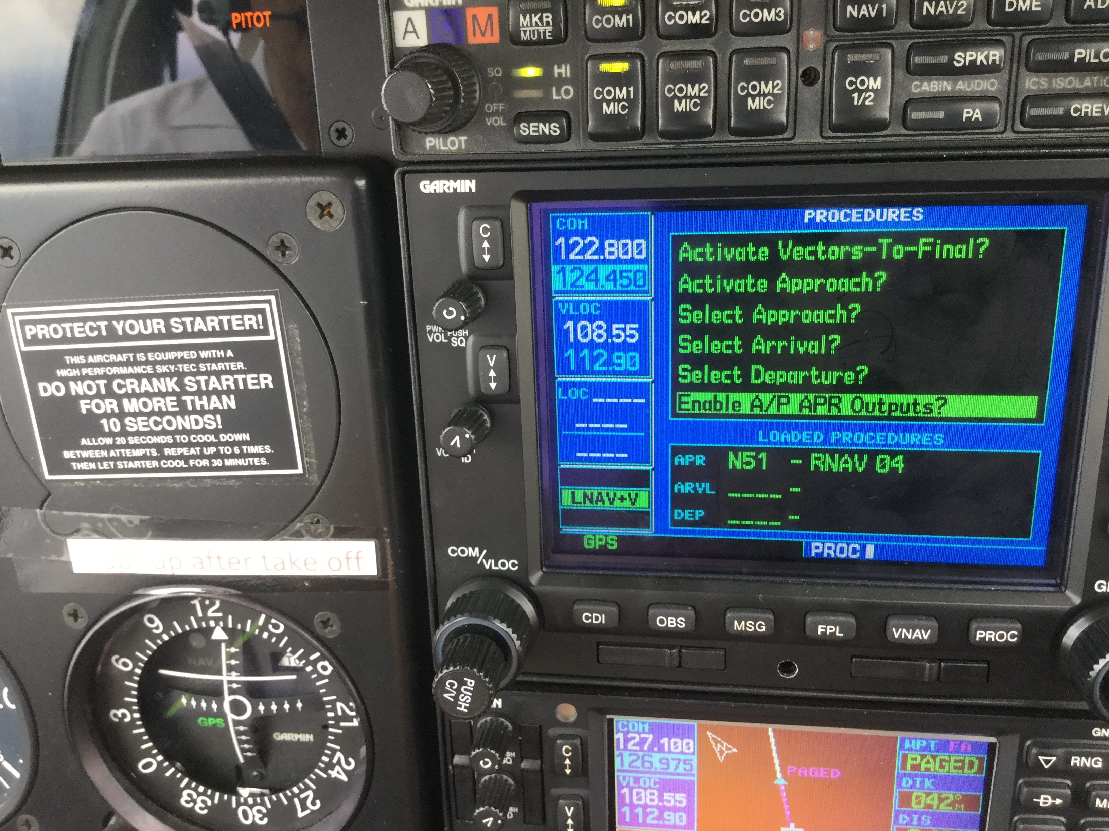
Indications During Approach - GPS

Slide 37
Indications During Approach - GPS
Three Step Summary (the “MPA flow”)
MSG (read the message)
PROC (select and accept the Procedure prompt)
APR (arm Approach on the autopilot)
BENDIX/KING
KAP 144
APR
AP
ALT
3000
ARM
BARO
P
T
GS
ALERT FT
UP
P
R
ARM
AP
HDG
NAV
APR
REV
ALT
DN

Slide 38
Indications During ILS Approach
BENDIX/KING
KAP 144
APR
AP
ALT
3000
ARM
BARO
P
T
GS
ALERT FT
UP
P
R
ARM
AP
HDG
NAV
APR
REV
ALT
DN
The glide slope will arm as soon as the LOC final
approach is captured and a valid ILS glides slope is
received . At glide slope intercept, ARM goes out and
GS replaces ALT or VS on the top line.
Note: Hold 90 KIAS minimum on approach (recommended)

Slide 39
Missed Approach
GNS 530 suspends automatic sequencing of waypoints at the missed approach, SUSP soft key is displayed
Disconnect the AP to execute a missed approach
Press CDI soft key on GNS 530 if required to select desired navigation source
Nav source will normally have to be changed back to GPS to fly procedure
Press SUSP soft key on GNS 530 to start sequencing of missed approach procedure
Ensure altitude restrictions of the published missed approach are followed before sequencing the missed approach procedure in the GPS
Do not engage AP below 800ft AGL
Set missed approach altitude into Altitude Alerter
Missed Approach altitude should already be set in Altitude Alerter during an ILS approach
After start of missed approach follow the same procedures as climb out

Slide 40
Effects of Equipment Failure
Failure of Attitude Indicator – No effect
Failure of DC turn coordinator - Autopilot disengages
Failure of HSI – No heading signal so ROL mode only
Failure of Transponder pressure encoder - Altitude alerter/preset fails
Failure of Trim servo – Auto pilot provides warning tone and disconnects – Manually control aircraft and then Press red dis-engage button to silence tone and pull autopilot circuit breaker

Slide 41
Adapted from Internet available presentation by:
Mike Prusak LtCol USAF (ret)
CAP-USAF STATE DIRECTOR
CAWG

